Slide 1

MACHINE LEARNING report
HEART DISEASE (UCI) DATASET

Slide 2
Key Points of Classification Problem
Heart Disease dataset has been taken to classify persons with and without heart disease.
All features of the dataset has been considered for the classification.
Various machine learning algorithms have been applied for the task.

Slide 3
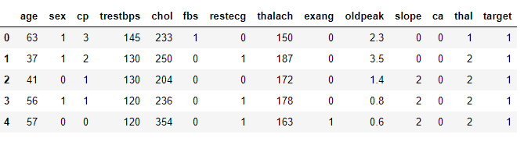
Heart Disease Dataset
The dataset consists of 14 columns and rest statistics have been explained in the python notebook.

Slide 4
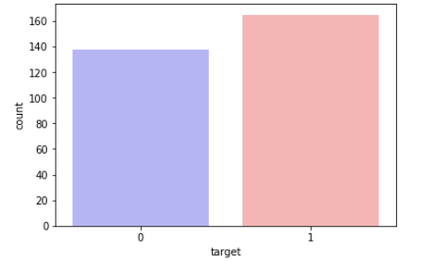
Target Distribution
This is a bar plot representation of the distribution of “Target” data.

Slide 5
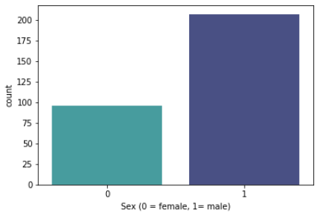
Representing distribution
This is distribution of the 1(male) and 0(female) data.

Slide 6
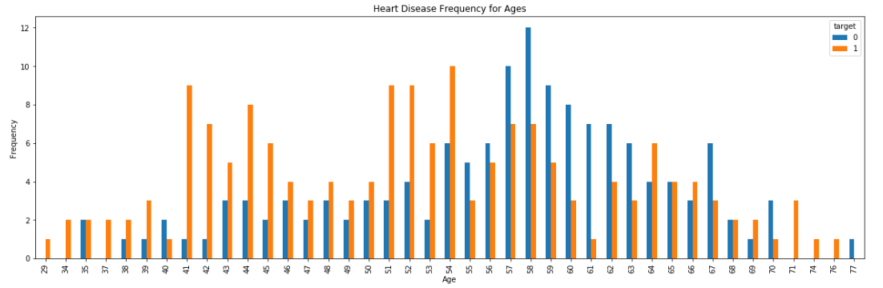
Heart Disease frequency for “Age”
This is a distribution of patients with and without heart disease as per their “Age”.

Slide 7
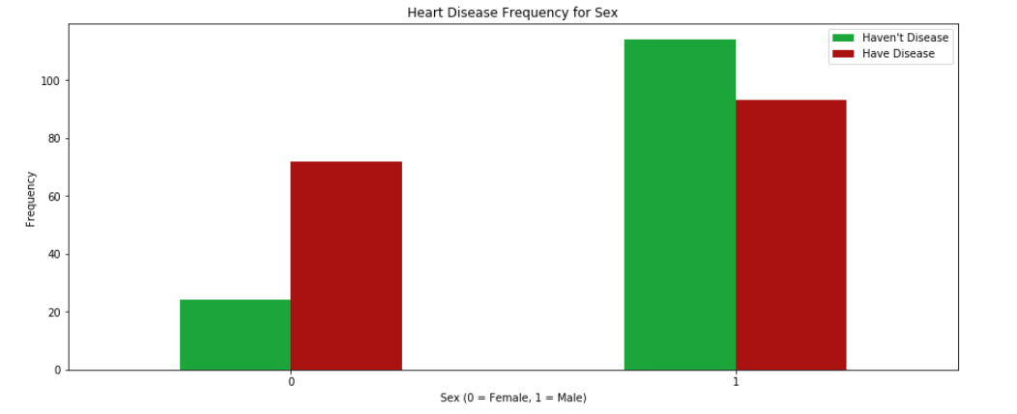
Heart Disease frequency for “Sex”
This is a distribution of patients with and without heart disease as per their “Sex”.

Slide 8
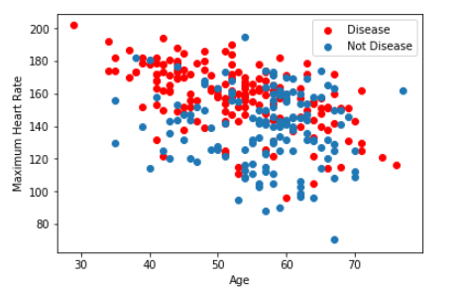
Age vs. Maximum heart rate
This is a distribution of patients with and without heart disease as per their Age vs. Maximum heart rate records.

Slide 9
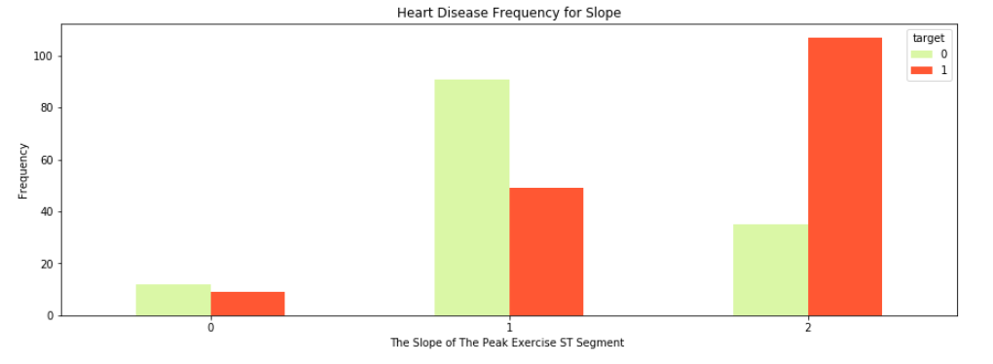
Heart Disease frequency for “Slope”
This is frequency of patients with and without heart disease as per the slope of the peak exercise ST segment.

Slide 10
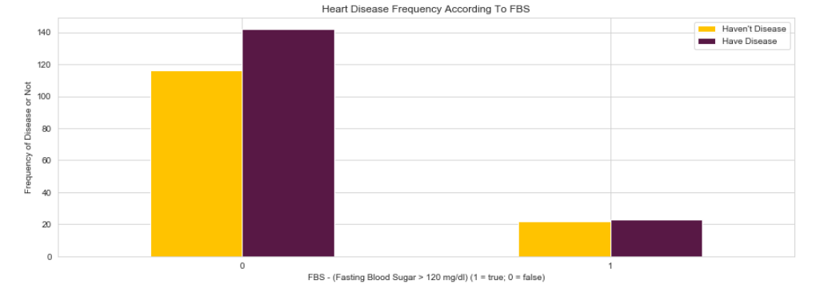
Heart Disease frequency for “FBS”
This is a frequency of patients with and without heart disease as per the fasting blood sugar.

Slide 11
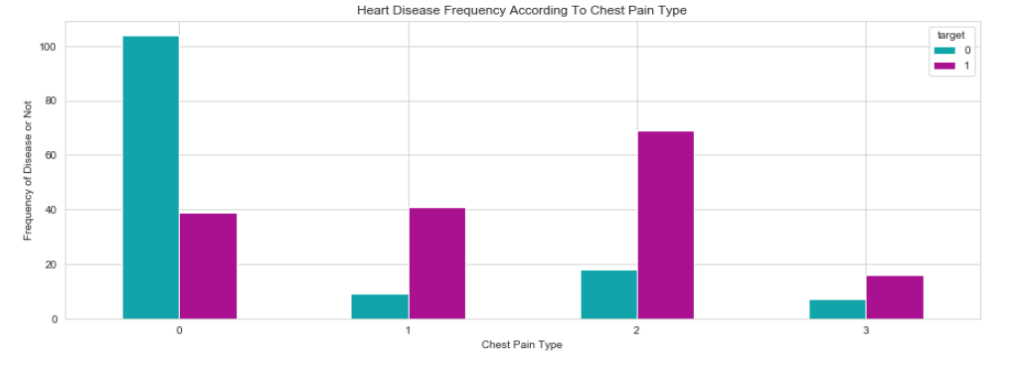
Heart Disease frequency for “cp”
This is a frequency of patients with and without heart disease as per the chest pain.

Slide 12
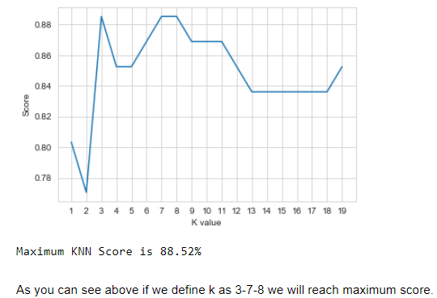
K-Nearest Neighbour (KNN) Classification
On applying the K-Nearest Neighbour classification, the accuracy is 88.52%.

Slide 13
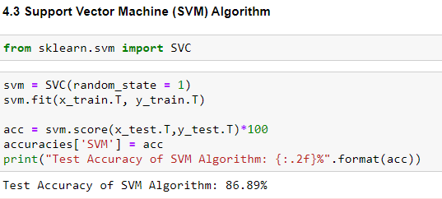
Support Vector Machine (SVM) Algorithm
On applying the Support Vector Machine algorithm, the accuracy is 86.89%.

Slide 14
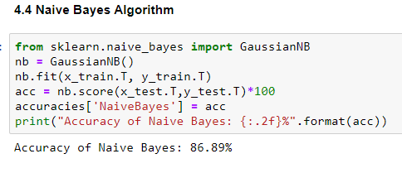
Naïve Bayes Algorithm
On applying the Naïve Bayes algorithm, the accuracy is 86.89%.

Slide 15
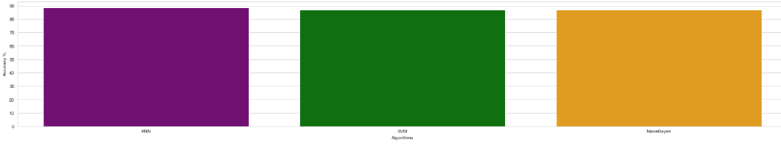
Comparing Models
Comparing accuracy score of all three models applied namely, KNN, SVM and Naïve Bayes.

Slide 16
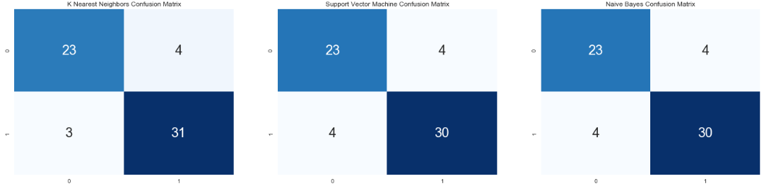
Confusion Matrix
Confusion matrix for all three models applied namely, KNN, SVM and Naïve Bayes.

Slide 17
This machine learning project has made me learn:
This project has helped me to apply various Machine Learning models and algorithms learnt for intermediate level.
The accuracy score of K-Nearest Neighbour classification being the most, makes it the best model among the three models applied on the dataset.
3. The conclusions derived from distribution plots are as follows:
The percentage of patients with heart disease are more i.e. 54.46%
The percentage of patients without heart disease are more i.e. 45.54%
4. The ‘Age’ with the most heart disease patient records is 54.
5. The Male patients are more exposed to heart diseases than females.

Slide 18

Thank You and Have a Good Day !

